Slide 1

WEBSITE ON SALON BUSINESS
S.N o | Name | Roll No | Registration no.
1 | Prashant Singh | RK17TSA20 | 11700932
2 | Shaik Arshad | RK17TSA07 | 11703603
3 | P.Nithin Sai | RK17TSA11 | 11703773
4 | Tummuru Aasritha | RK17TSA05 | 11702426

Slide 2

Introduction
Website based on Salon Business and helps in managing it
Has a smooth user interface to explore the website
Interactive webpages with the help of JavaScript
Designed using Cascading Style Sheet(CSS) and developed using HTML

Slide 3
Background & Objective
Based on an existing business of salons based in Hyderabad
Objectives
To learn HTML & CSS to create a website
To learn the use of JavaScript to provide an interactive interface
To learn to combine all the components to create a professional looking website

Slide 4
Work Division Among Students
1.Nithin Sai: Collected information about our target business i.e., Alexander Salons. Collected the pictures, locations and about the branches of salons. Also collected information about the staff working at different branches. Completed the web pages of Contact and About .
2.Prashant Singh : Did the basic web designing. Wrote the HTML and CSS code for the Homepage of the website and designed the membership page including login. Helped completing one of the branches.
3.Shaik Arshad : Completed feedback form and three of the branches that includes, Himayath Nagar , Abids and Assembly branch. Also helped writing the report and providing innovative ideas for implementing project.
4.Aasritha : Completed two branches including Film Nagar branch and Attapur branch. Helped arranging files systematically and also helped in linking the css, html and java script files. Also helped in creating the feedback form and other designs.

Slide 5
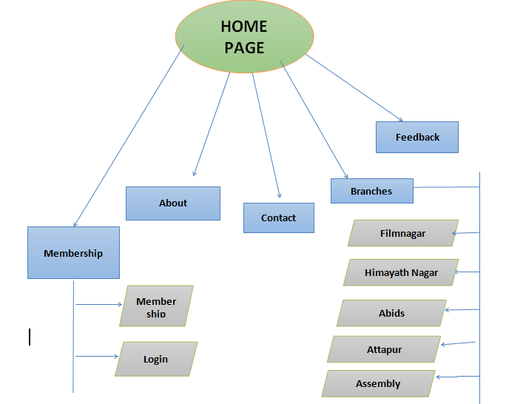
Pictorial Flow chart of Website:

Slide 6
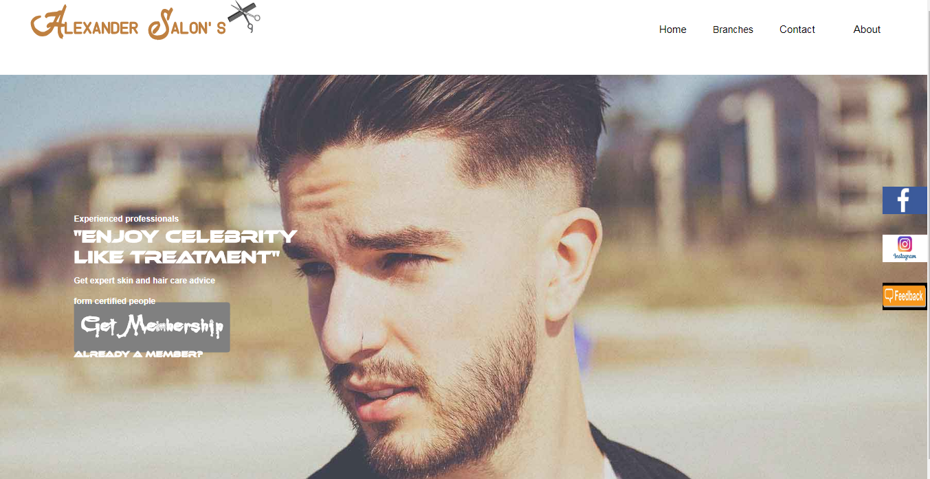
Home page
It has navigation bar that links to all other web pages that includes
Branches
About
Contact
Membership
It also links to Facebook, Instagram and feedback form through buttons fixed at right side.

Slide 7
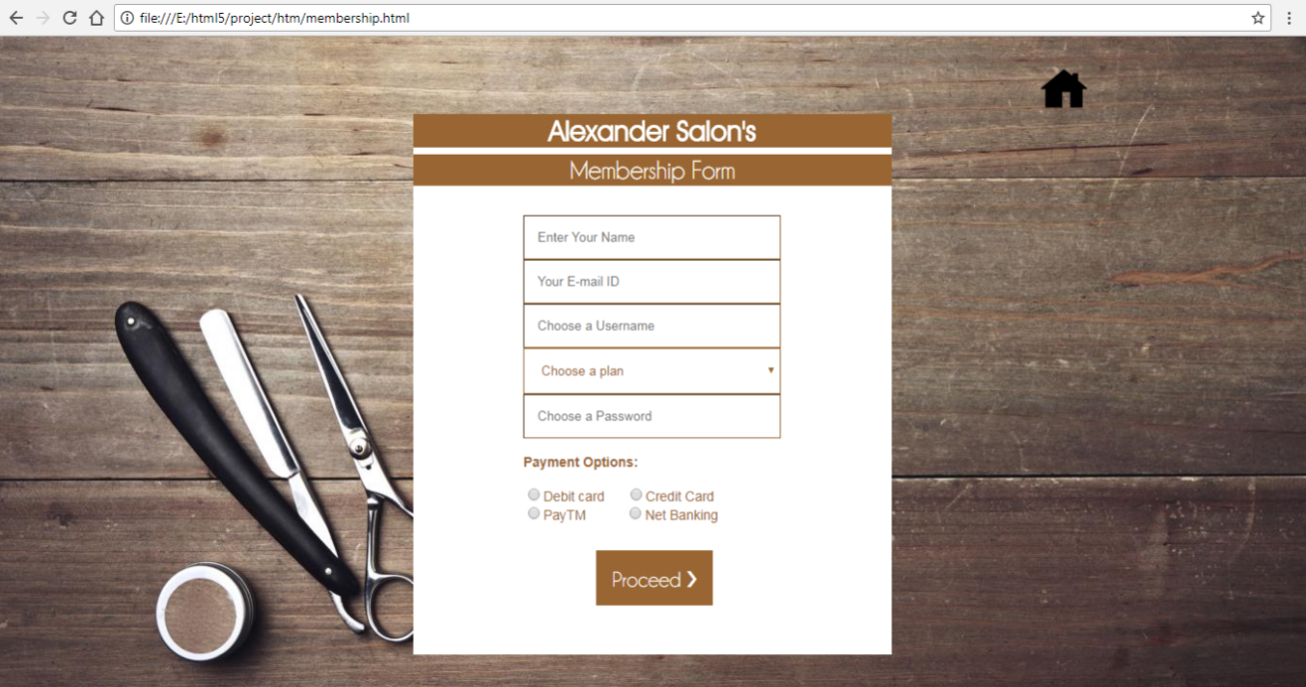
Membership page
This is the membership form. In this personal details are filled up and payment mode is selected. This also uses JavaScript validation.

Slide 8
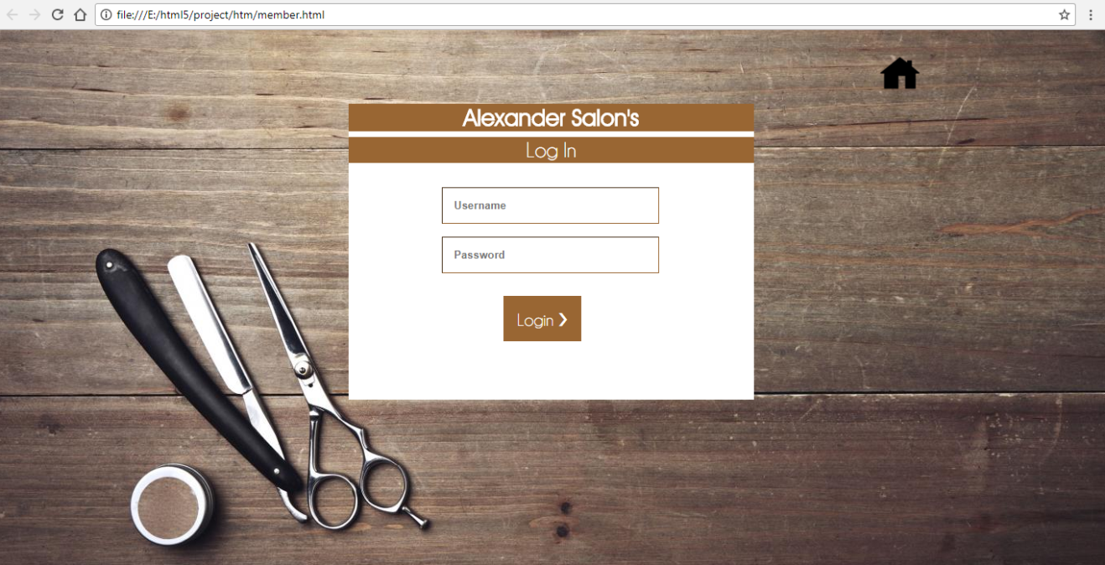
Login page
This is the login form that can be accessed by clicking ‘Already a member’ link on home page, it also uses JavaScript validation.

Slide 9
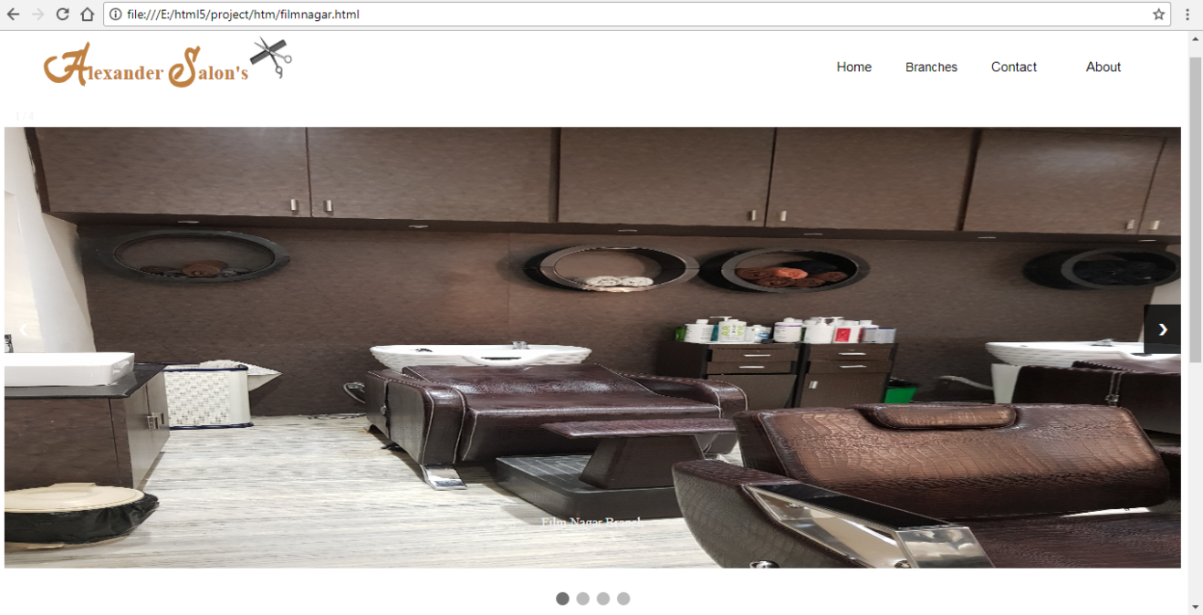
Branches

Slide 10
There are total five branches that include:
Film Nagar
Himayath Nagar
Abids
Attapur
Assembly
Each of the branch pages have slideshow of their respective shops that shows three to four images as you navigate through the slideshow.

Slide 11
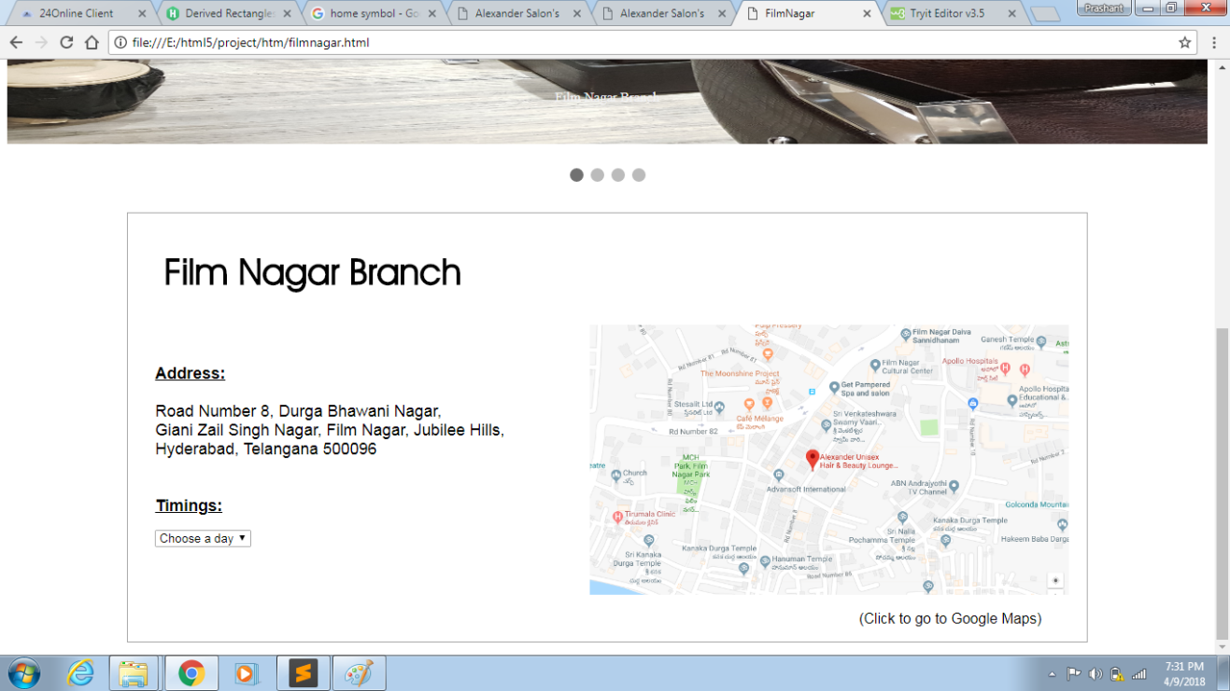
We have also provided a location link using Google maps that redirects to the location, alongside the address.

Slide 12
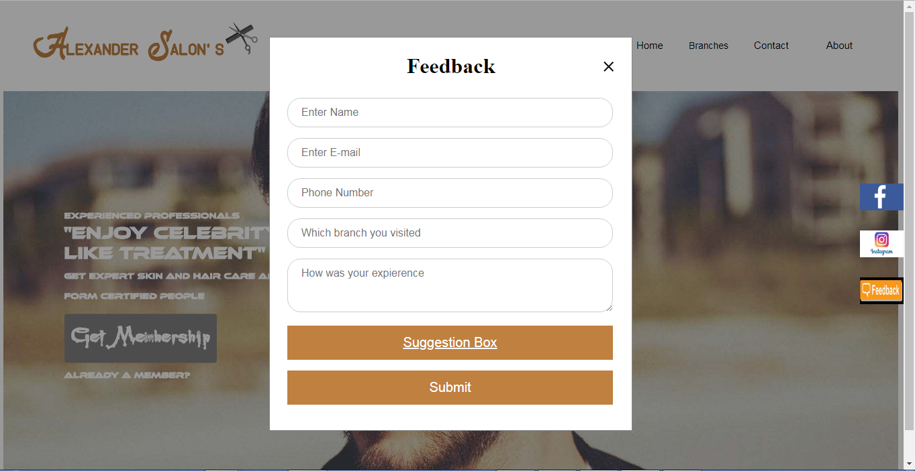
Feedback
This page lets the user to give their feedback, it also leads to an open suggestion box where the user can give their suggestions that is pinned to the website.

Slide 13
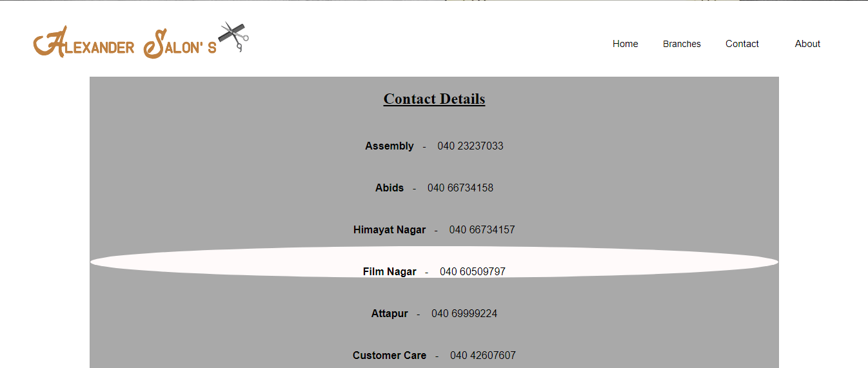
CONTACT
This page has pseudo property like hover to change the contents when mouse is over the contact details then the properties of that contact details changes

Slide 14
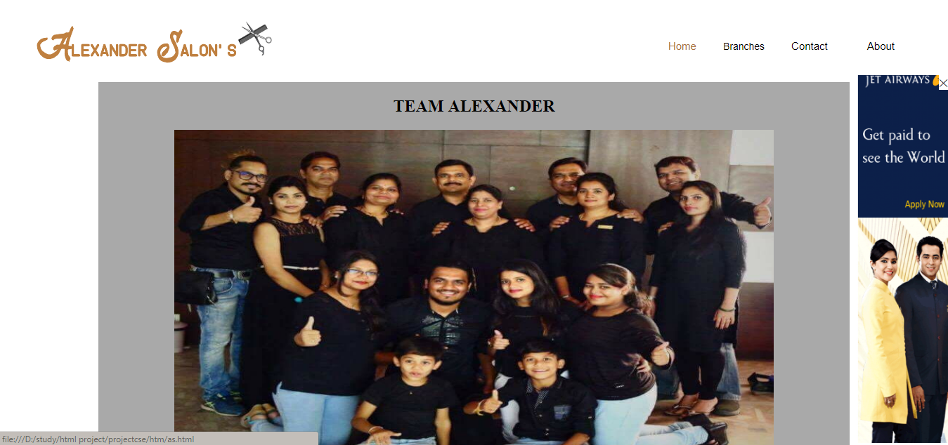
ABOUT
This page gives a brief about the company with different photos.It also has a advertisement which can be closed by clicking on close button

Slide 15

Rate Card
This page has CSS,JS and Animation. Java Script is used to change the contents inside a tag while CSS is used to change the properties and the image has animation property so that the image moves from one place to another.

Slide 16
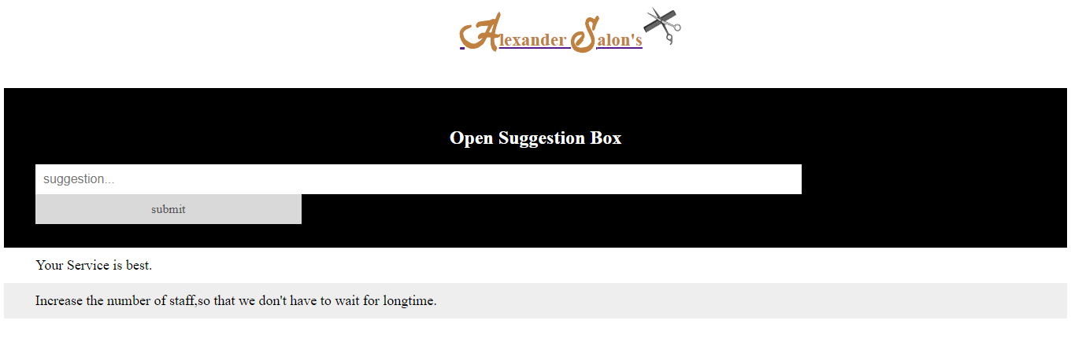
OPEN SUGGESTION BOX
This is a open suggestion box where the user can add his suggestion to the page.This is possibly by Java script.

Slide 17
S.W.O.T. Analysis
Strengths
Our website is based on a well established business. The entire website is designed by us and hence its design is hundred percent genuine.
Weakness
As this is our first time designing a website, hence we might not be able to be up to marks at some points. Our website is just a static model and it doesn’t have any backend.
Opportunities
This website provided us means to explore our creative designing abilities, it also helped us understand what goes behind web development. We got the opportunity to create our very own website through what we learned.
Threats
No serious threats as of now. Copying of ideas and code could be one possible threat.

